Slide 1
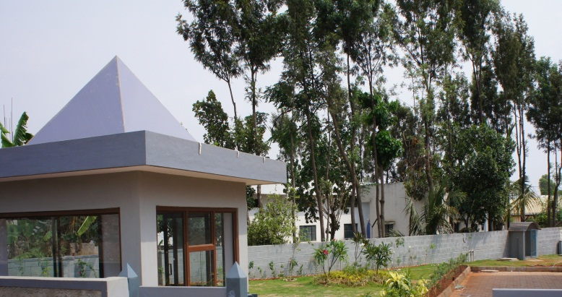
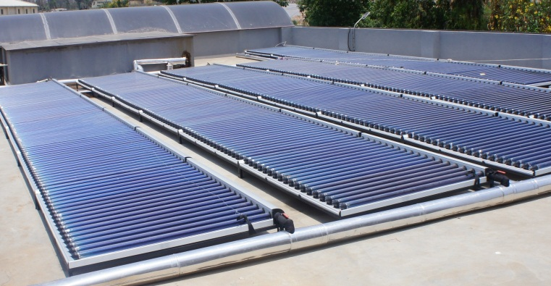
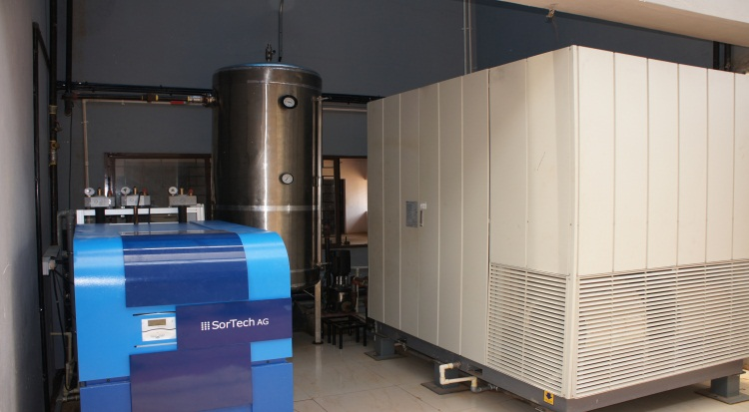
VSM Solar Pvt. Ltd.
Solar Thermal solutions
A Fraunhofer Joint Venture Company
Details of the solar collectors for steam production
Channel Partners to MNRE
Ministry of New and Renewable Energy

Slide 2
VSM Solar Collectors – Steam Generation
Thermal Vacuum based TVP collectors manufactured by TVP, Switzerland.

Slide 3
VSM Solar Collectors – Steam Generation
Thermal Vacuum based TVP collectors manufactured by TVP, Switzerland.

Slide 4
VSM Solar Collectors – Steam Generation
Thermal Vacuum based TVP collectors manufactured by TVP, Switzerland.

Slide 5
TVP Installation - ORF Ras Al Khaimah, UAE
System Description:
i).Solar Thermal Industrial Process Heat for a Rubber Factory.
ii).Solar Field Ground Mounted.
iii).Daytime Operation – Average 8 hrs/Day for 300 Days/Year.
System Details:
i).No of Collectors – 120 Nos
ii).Installed Area – 432 Sq.Mtrs.
iii).Operating Temperature: 175°C
System Parameters:
TVP System HTF (Water) Operating T : 175°C
With Client Circuit operating at 155°C
Integration Component: Plate Heat Exchanger
Client Circuit HTF : Thermic Fluid
Sunlight Threshold: Minimum 300 w/m²

Slide 6
TVP ORF Installation – Field & Main Array

Slide 7
TVP Solar Field Innovations
First commercial deployment of MT-Power v4
TVP Unique Innovations: Panel-Embedded HTF Return Flow
High number of panels per string
No external piping at string level
Panel-to-panel and end-connectors have individual insulation boxes to further reduce piping losses
Benefits
Significantly reduced system thermal losses at piping level (-10%)
Lowered balance of system costs (-30%)
Faster, easier panel interconnection and string installation, and smaller installation area
Reduced pressure drop across each string

Slide 8
TVP ORF Schematics

Slide 9
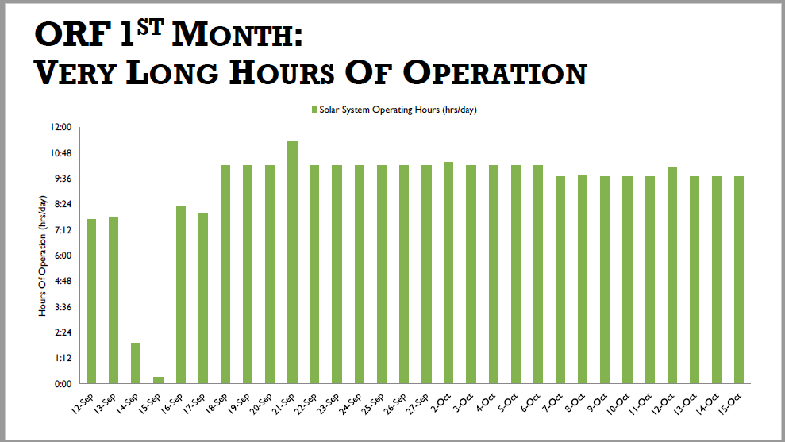
TVP ORF Performance

Slide 10
TVP received 3 very important international awards, below the details: WIPO Innovative Enterprise Award 2012 – Geneva, Switzerland Launched in 2000, the World Intellectual Property Organization (“WIPO”) Innovative Enterprise Award is presented yearly as ameans of promoting the public awareness of the IP system and of its advantages for businesses. The award is a distinction given to companies that are actively using the IP system in their research, development, production or commercial activities. TVP Solar won the WIPO Award for the solar air-cooling demo project at the Marrakesh testing platform of the Agence Nationale Pour le Développement des Energies Renouvelables (“ADEREE”).
TVP Awards

Slide 11
TVP Awards
Intersolar Award 2012 – Munich, Germany
Competing against over 3.500 companies from China, Europe, North America and India, TVP Solar received the prestigious Intersolar AWARD for its MT-Power panel as most innovative product in 2012 within the solar thermal industry. In its fifth year, the AWARD is attributed to pioneering technology debuting during the Intersolar exhibitions, which have either undergone industrial trials or are already in industrial use. Key decision criterion lay in innovation, efficiency and cost reduction, such as via materials, production methods and ease of integration. MT- Power provides high conversion efficiency at temperatures between 100-180°C without concentration thanks to high- vacuum insulation.

Slide 12
TVP Awards
Nova Energy Award 2009 – Paris, France
Launched in 2008, the NOVA Energy Prize was awarded in its 2009 second edition to TVP Solar by Saint-Gobain for the most innovative clean-tech energy start-up, selected from 50 others participating in the international “Nova External Venturing” competition organized by Saint-Gobain. Based on its breakthrough glass/metal seal innovation, value proposition and potential synergies with Saint-Gobain in solar energy, TVP Solar was awarded the prize by a panel of judges comprised of senior executives and chaired by Pierre-André de Chalendar, CEO of Saint-Gobain.

